Slide 1

Natalia Pulina
Country: Sweden
Company: Klarna
Role: Software Engineer
Github: https://github.com/pulitta

Slide 2

17
Smoooth Payments
170k
$5.5B
60M

Slide 3
Property-Based Testing:
Must-Haves in Software Development

Slide 4
Agenda
What is property-based testing?
Ways of testing
How to come up with properties?
Stateless and stateful properties

Slide 5

What is property-based testing?

Slide 6
Property Based testing libraries
Erlang: QuickCheck, PropEr
Haskell: QuickCheck, leancheck
C++: QuickCheck++, rapidcheck
Java: jqwik
Python: Hypothesis
JavaScript: Marmelab
…

Slide 7
Property-Based testing
way of testing that checks properties of tested function.
rule
properties
example1
true
example2
true
example3
false

Slide 8
Two ways of testing
Example-Based way
Property-Based way

Slide 9
Example-based way
traditional way of testing when user gives list of examples to verify that a function works as expected.
Unit tests -
good representatives of this type of testing.

Slide 10
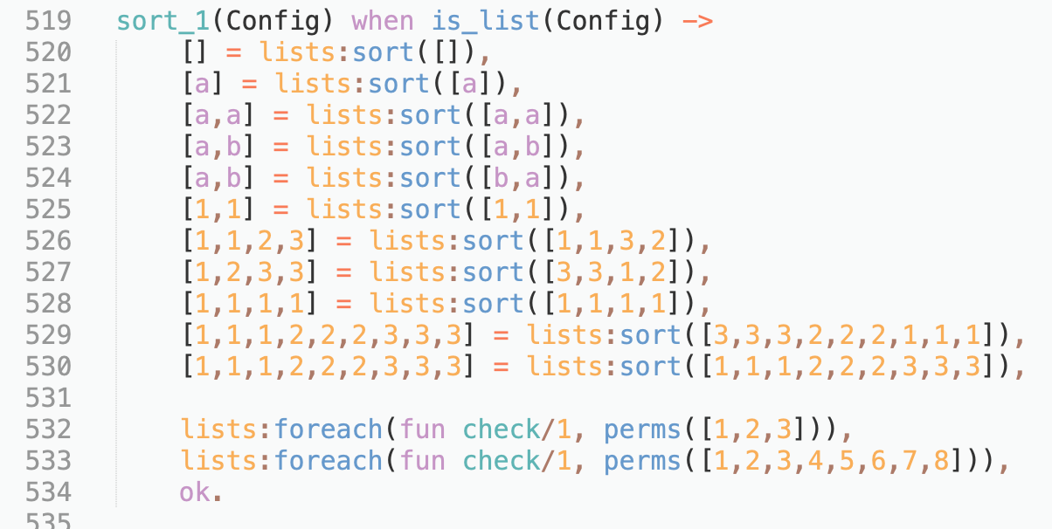
Example-based way

Slide 11
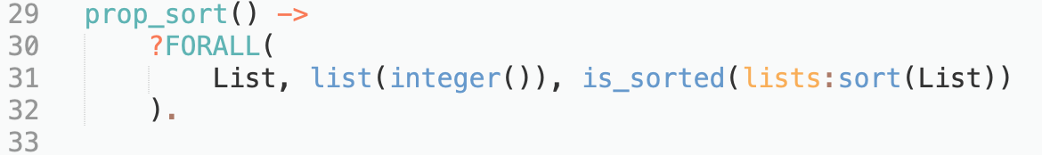
Property-based way
PropEr interface
Variable
Generator
Property

Slide 12
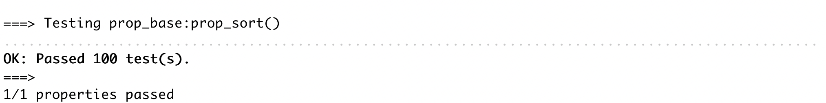
Property-based way

Slide 13
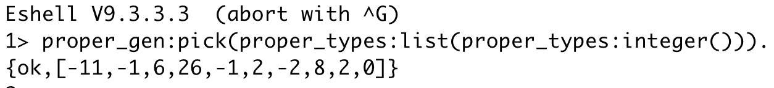
Property-based way
...

Slide 14
Ensures that code does what we expect
Two ways of testing
Example-Based way
Property-Based way
Explores the program’s behaviour to see what it can or cannot do

Slide 15

How to come up with properties?

Slide 16
Thinking in Properties. Techniques:
Modeling
Generalizing Example Tests
Invariants
Symmetric Properties

Slide 17
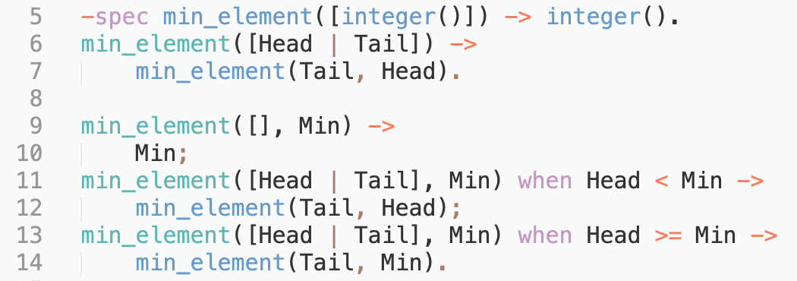
Function `min_element`

Slide 18

Modeling
requires you to write an indirect and very simple implementation of your code and pit it against the real implementation.

Slide 19
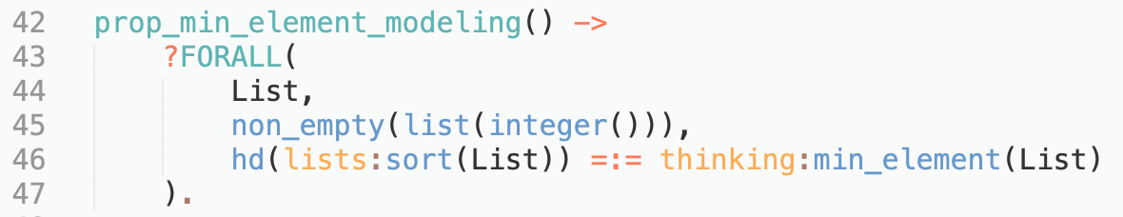
Modeling
Model

Slide 20

Generalizing Example Tests
start by writing a regular unit test and then abstract it away.

Slide 21
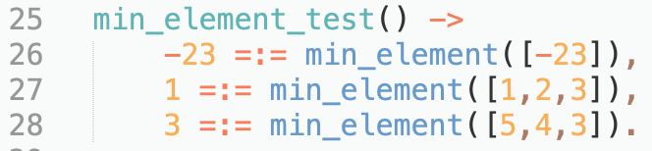
Generalizing Example Tests

Slide 22
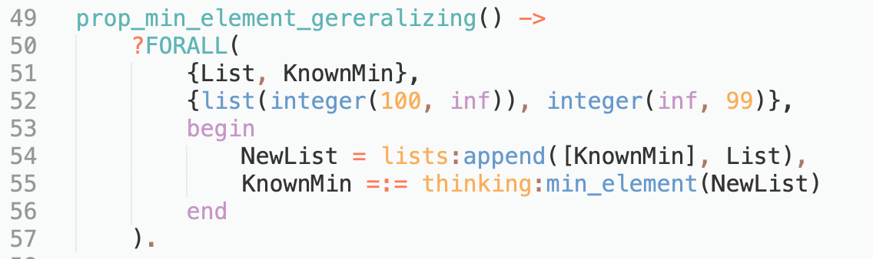
Generalizing Example Tests
Generator
Append operator

Slide 23

Invariants
requires identifying facts about a system that should always remain true.

Slide 24
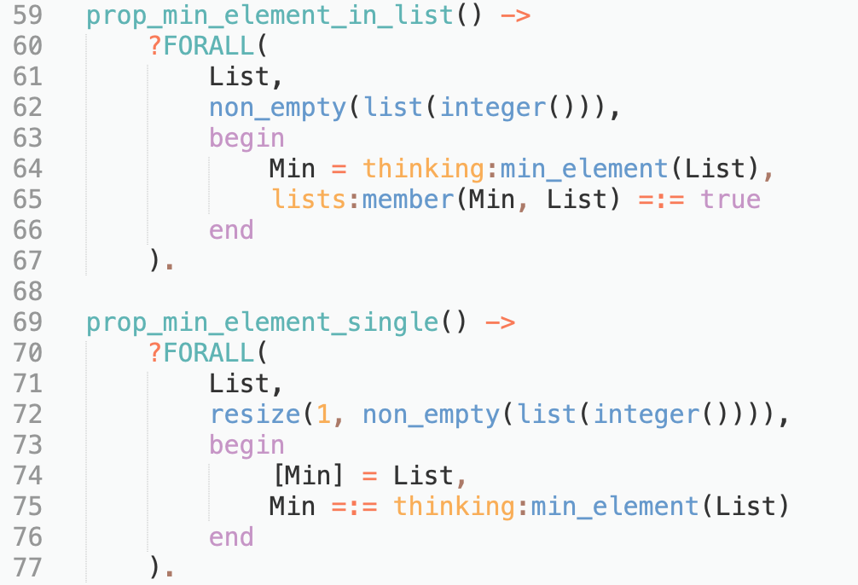
Invariants
Element in the list
Generator
List of one element

Slide 25

Symmetric properties
assemble a reversible sequence of actions together.

Slide 26
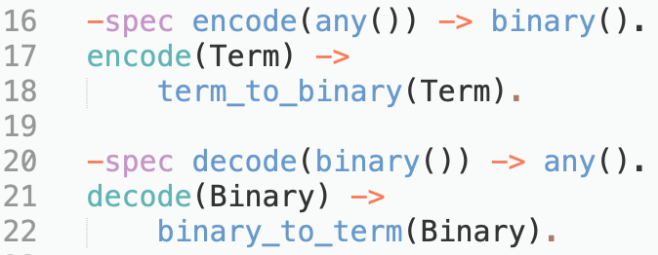
Symmetric properties

Slide 27
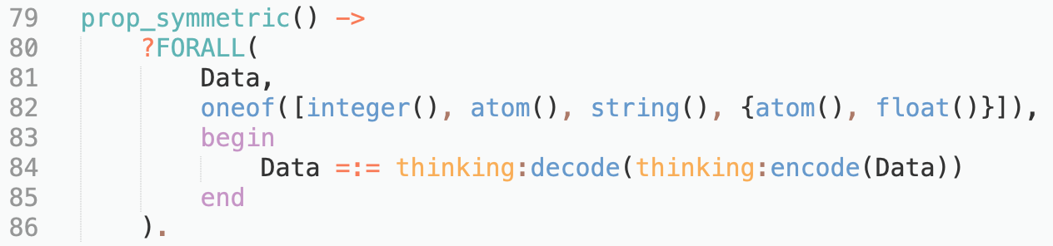
Symmetric properties
Symmetric actions

Slide 28
How to come up with properties?
modeling
generalizing examples
invariants
symmetric properties

Slide 29
State properties
less
full

Slide 30
Stateless properties
Dependent only on input
No state
Isolated components
No major side effects:
Writing data to the disk
Storing data to the database
Logging data

Slide 31
Stateless properties
Generator
Data
Property
true
Passed
Failed
false

Slide 32
Stateful properties
Non-formal variation on model checking
Dependent on state and preconditions
Complex systems
Integration and system tests

Slide 33
Components
Model
Generator
Validator

Slide 34

Model
represents a simple and straightforward version of what our system should be doing.
State
Next state

Slide 35
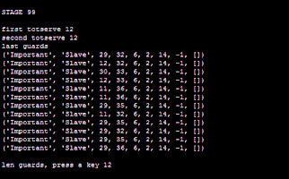
Commands
represent operations that can be run against the actual system.
Operations
Preconditions

Slide 36

Validator
does validation of the system against the model.
Postconditions

Slide 37
Stateful properties
false
Init
Command
Precondition
Next state
Abstract
FAIL
Init
Command
Precondition
false
error
Real
Call
Postcondition
Next state

Slide 38
State properties
less
full

Slide 39

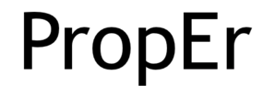
Examples of problems
Ghost keys in Google’s levelDB
Faults in CAN-bus stack in AUTOSAR
Date issue in RTBF script - Klarna

Slide 40
Less code
High coverage
Easy to find corner cases
Limited scope
Too much time to execute a test
Requires experience

Slide 41
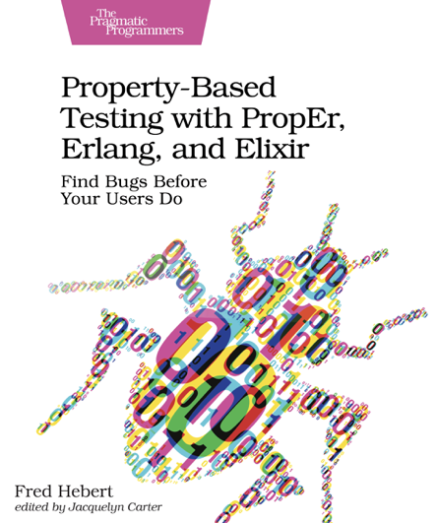



Slide 42
Resources
https://propertesting.com
https://www.cs.tufts.edu/~nr/cs257/archive/john-hughes/quviq-testing.pdf
https://github.com/pulitta/perspektywy_2019

Slide 43
Thank
you!

